Slide 1
Privacy Protection in Studies about Coronavirus disease (COVID-19)
Group number: 17
Group members: Jordan Turley, Qiuyang Yin, Qiang Fei

Slide 2
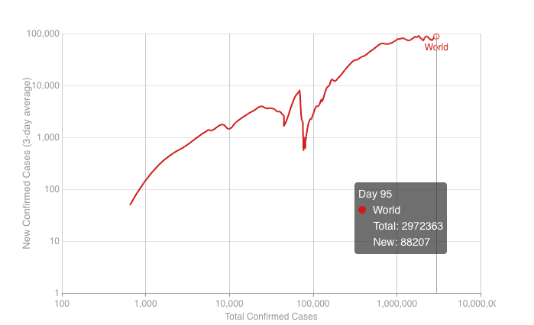
Introduction
Datasets:
China
South Korea
India
Image taken from https://coronavirus.1point3acres.com/zh/world

Slide 3
Privacy Protection in Chinese Dataset

Slide 4
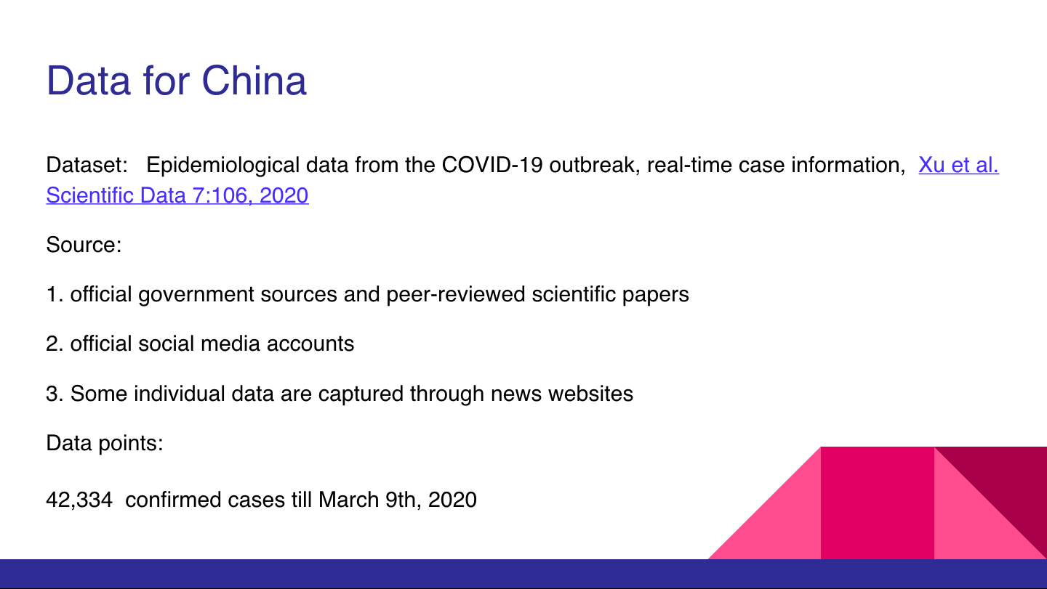

Slide 5
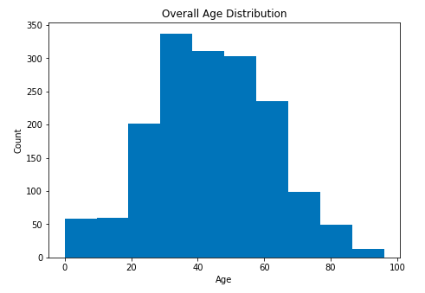
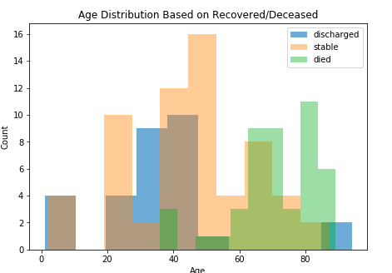
Data for China

Slide 6
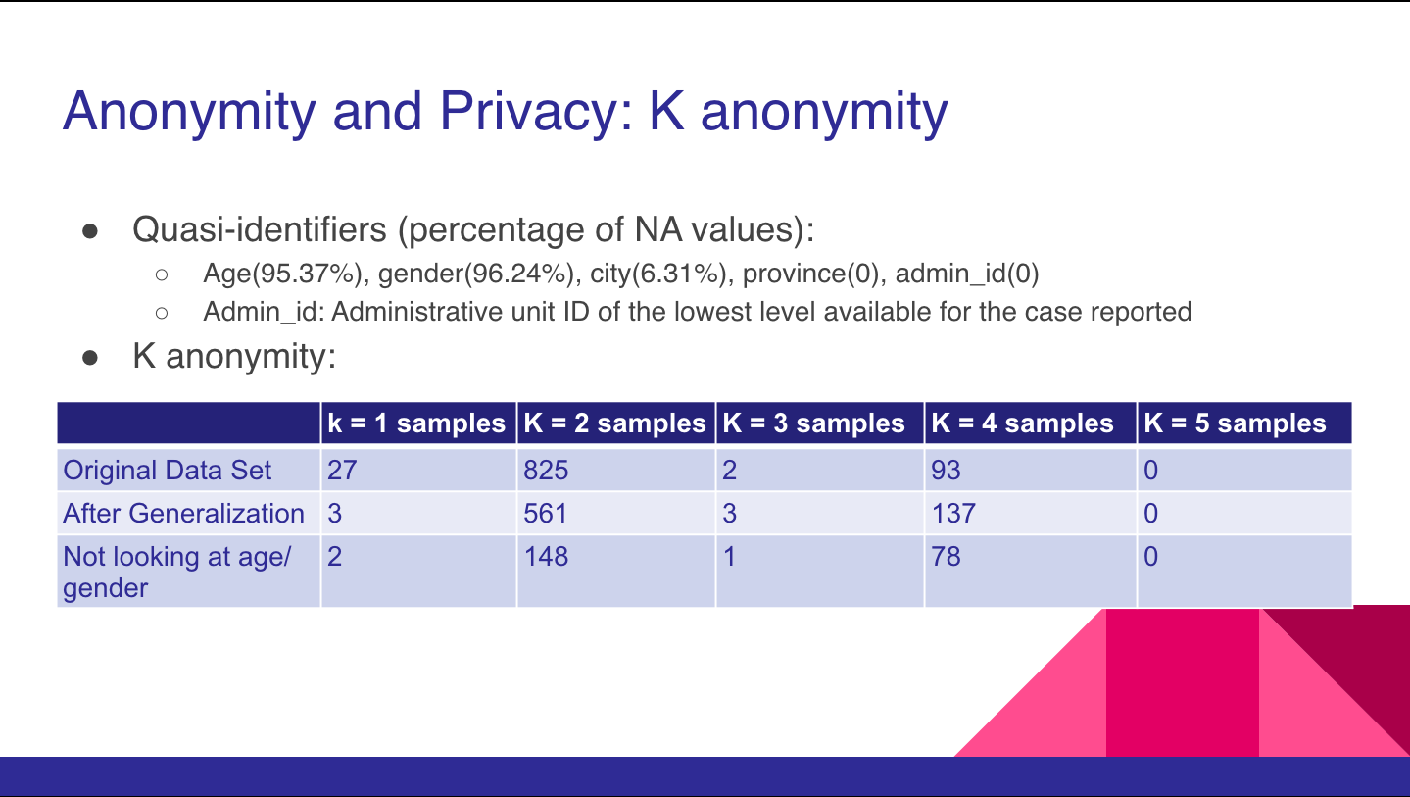

Slide 7
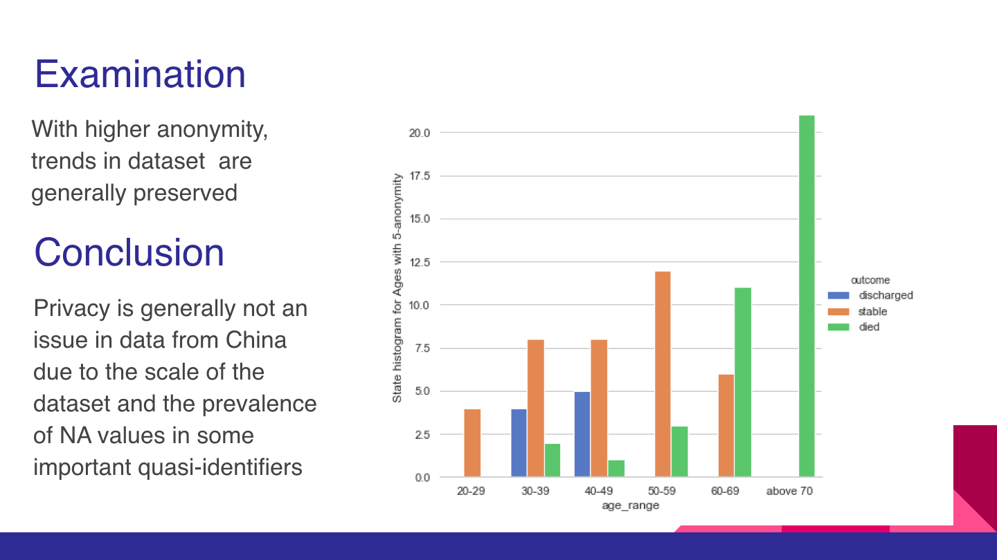

Slide 8
Privacy Protection in South Korea Dataset

Slide 9
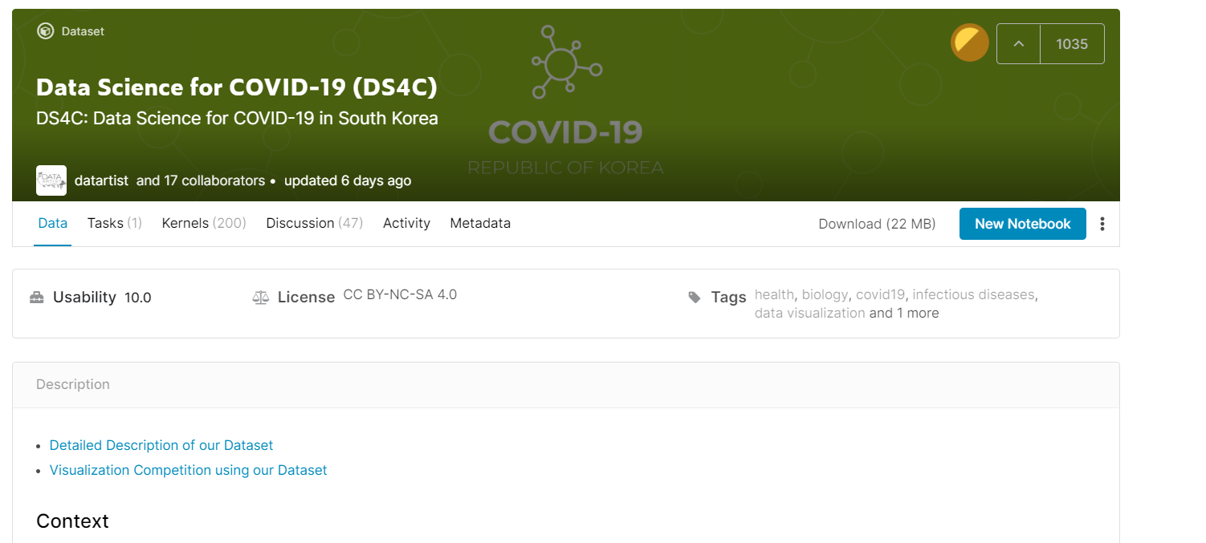
Dataset Description
Original Source of data: KCDC (Korea Centers for Disease Control & Prevention)
Hosted by DS4C (Data Science for COVID-19) Project
Last updated: 2020-04-27

Slide 10
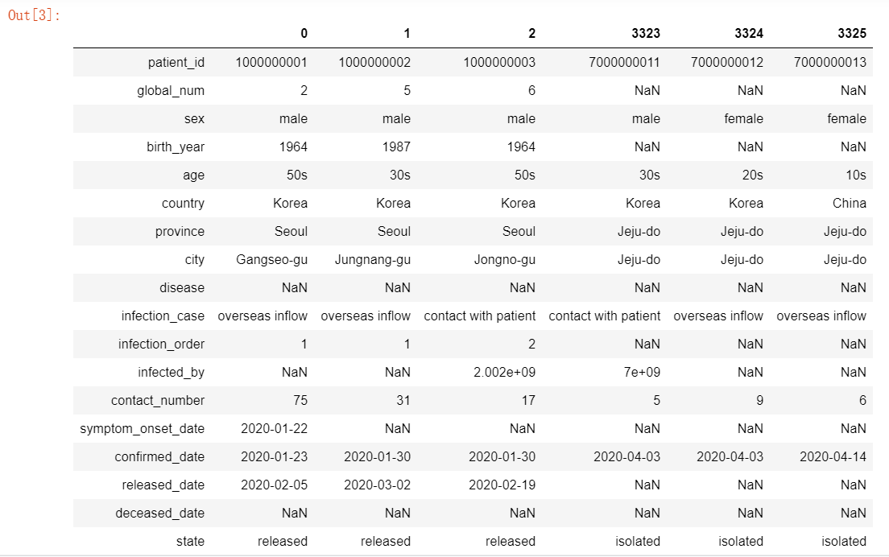
Dataset Description
We focus on individual-level data
Patients: 3326
Recovered: 1637
Still isolated: 1622
Deceased: 67

Slide 11
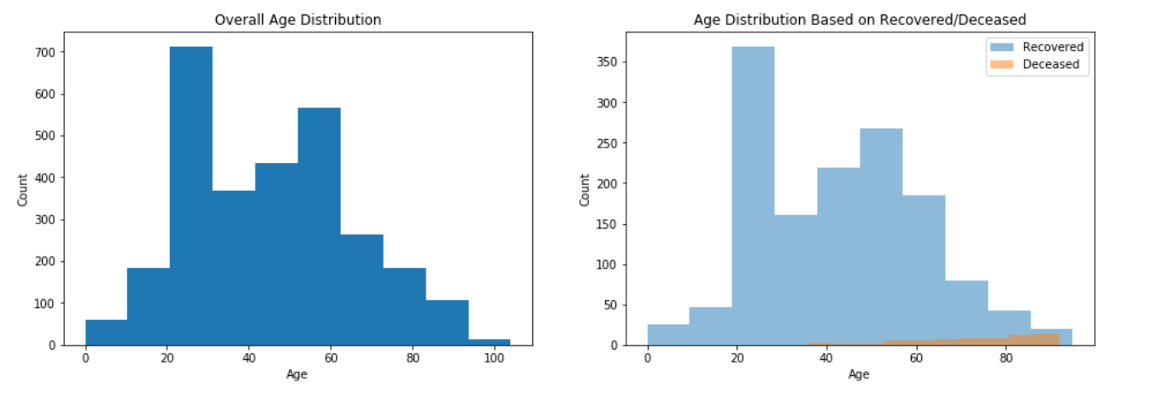
EDA: Age
3300+data, ~2900 with birth year.

Slide 12
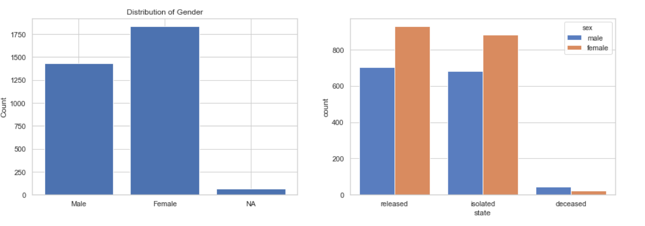
EDA: Sex

Slide 13
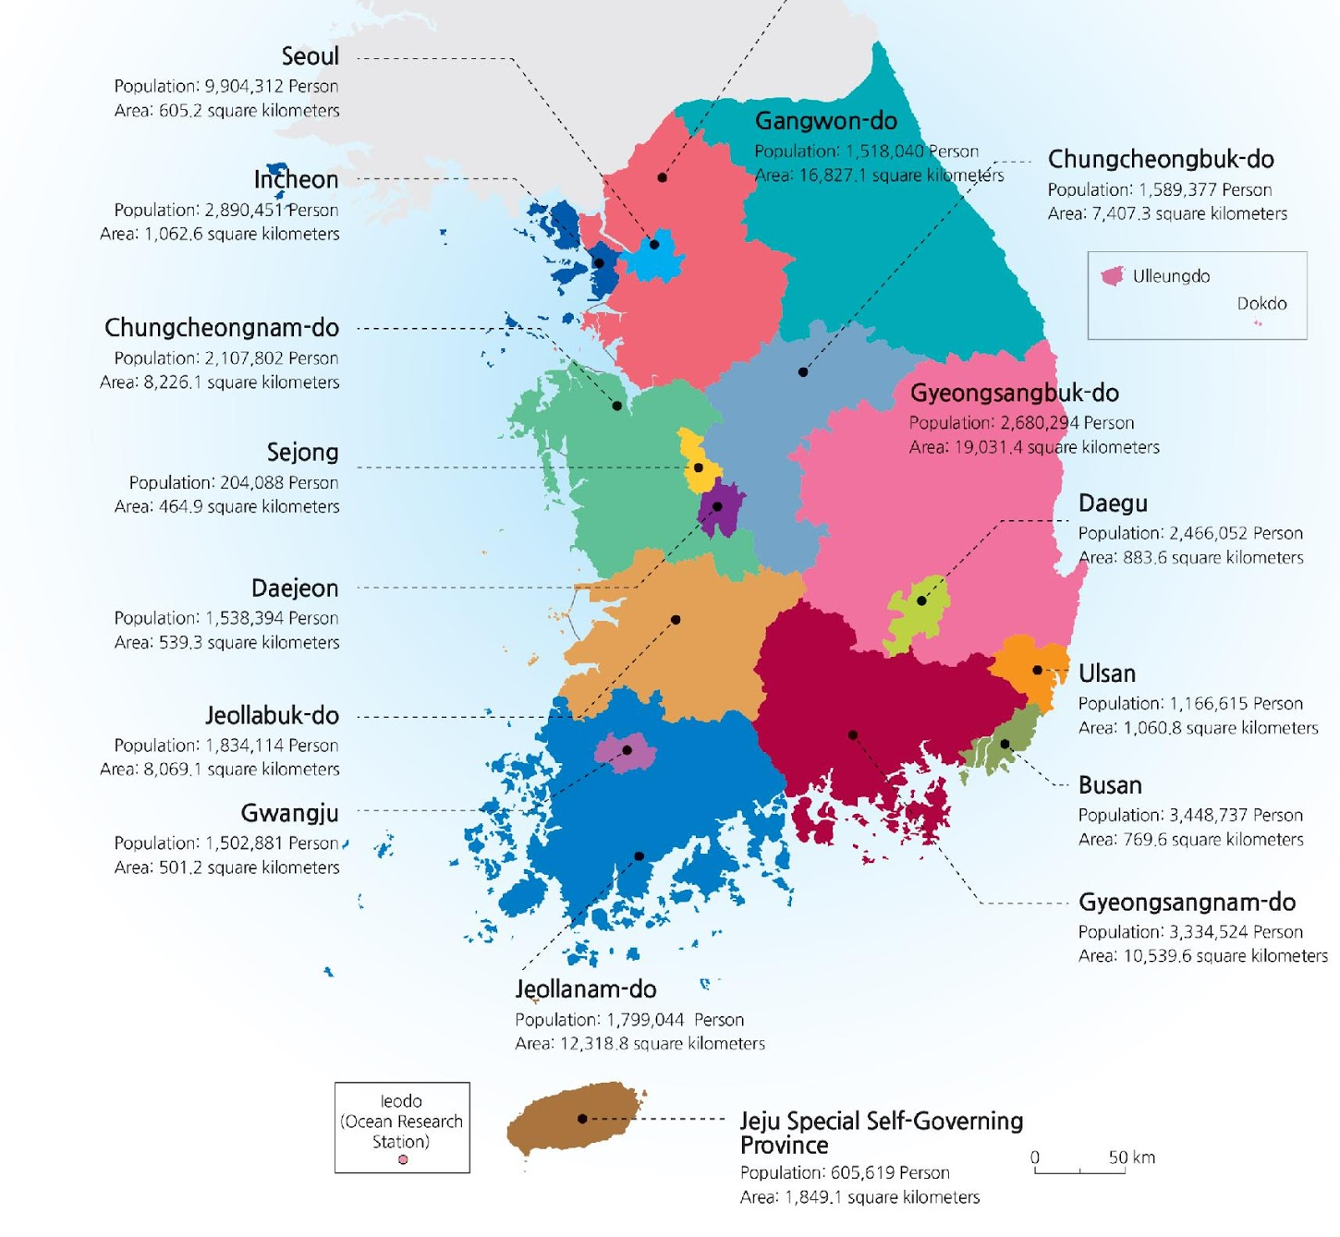
EDA: Region
Image from https://www.kaggle.com/kimjihoo/ds4c-what-is-this-dataset-detailed-description
Region includes province and city
Korean:
-do province
-si city
-gun country
-gu district

Slide 14
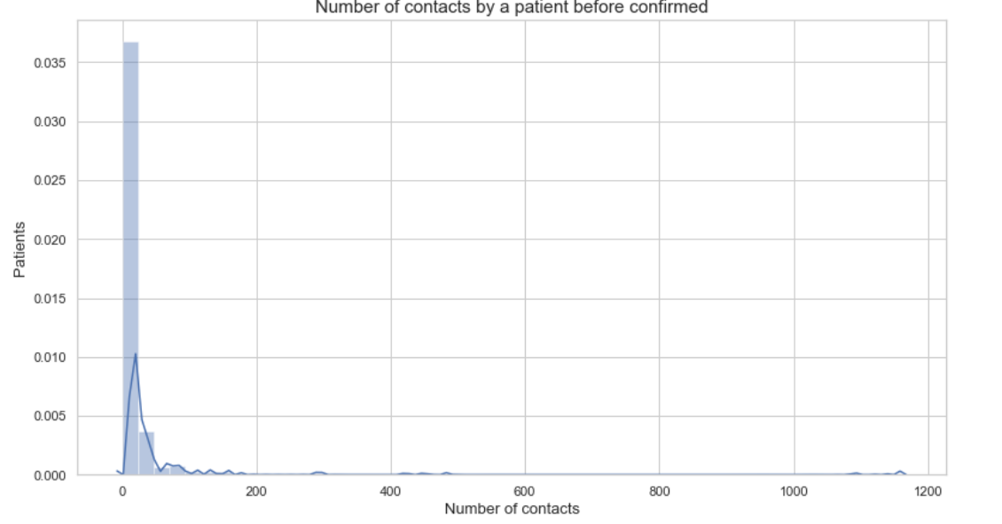
EDA: Other Features
Infection Order
1 = not infected by other patients in S. Korea
2 = infected by the 1st-order patient
…
Useful but too few (only 30 data points)
Number of contacts
0 = no contact with other patients
1 = contacting (and possibly infecting) 1 other person
and so forth

Slide 15
Anonymity and Privacy: K anonymity
Quasi-identifiers:
Sex, birth year, age, country, province, city
Other features like confirmed date, number of contacts are supposed to be publicly known.
K anonymity:
k = 1 samples | K = 2 samples | K = 3 samples | K = 4 samples | K = 5 samples
1687 | 262 | 64 | 32 | 14
Considering we only have 3300 samples, more than half of samples are unique, which is sure to be "unsafe"

Slide 16
Fix k-anonymity: Generalization
Generalize birth year to age period (10s, 20s, 30s, etc)
Generalize city to province
methods | K = 1 samples | K = 2 samples | K = 3 samples | K = 4 samples | K = 5 samples
Original | 1687 | 262 | 64 | 32 | 14
Age period | 567 | 217 | 118 | 71 | 34
Age period + province | 52 | 29 | 29 | 21 | 14
We can then do suppression to ensure k-anonymity
Q: Which generalization is better?

Slide 17
Compare methods: on predicting recover time
Hard to predict recover or death: too low death rate! (which means too few death samples)
Recover time = release date – confirmed date
Model:
linear regression
one hot encoding for category variables
80/20 train test split
Fill NA with mean

Slide 18
Compare methods: on predicting recover time
methods | Number of samples | Train R2 | Test R2
Original | 1218 | 0.229 | 0.036
Age period + suppression | 872 | 0.155 | 0.009
Age period + province + suppression | 1136 | 0.164 | 0.101

Slide 19
Privacy Protection in India Dataset

Slide 20
Dataset
https://www.covid19india.org/
Unofficial, uses “state bulletins and official handles to update our numbers”
Dataset specifically of 7000 deaths and recoveries (quasi-identifiers in bold)
Date
Age Bracket
Gender
Patient_Status
City
District
State
Statecode
Notes
Nationality

Slide 21
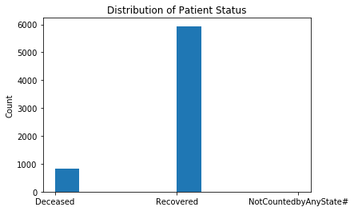
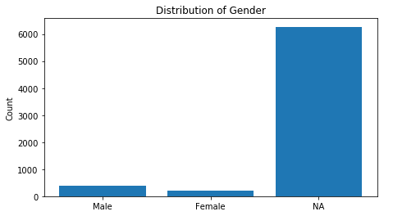
Exploratory Data Analysis

Slide 22
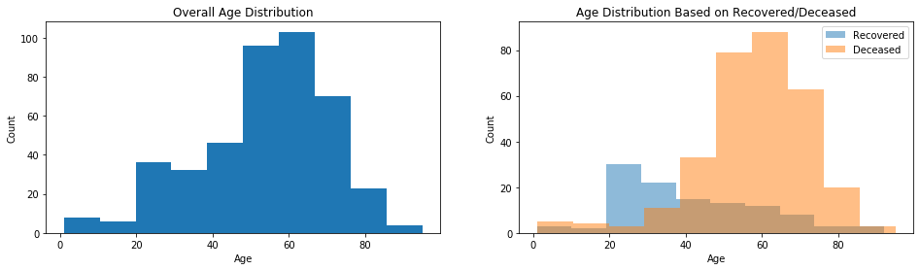
Exploratory Data Analysis

Slide 23
k-Anonymity
Use suppression to achieve 3-, 4-, and 5-anonymity
Quasi-identifiers: Age, Gender, City, District, State/Statecode, Nationality
k = 1 observations | k = 2 observations | k = 3 observations | k = 4 observations | k = 5 observations
417 | 56 | 24 | 16 | 12
Original Dataset | K = 3 | K = 4 | K = 5
6853 observations | 6252 observations | 6188 observations | 6128 observations

Slide 24
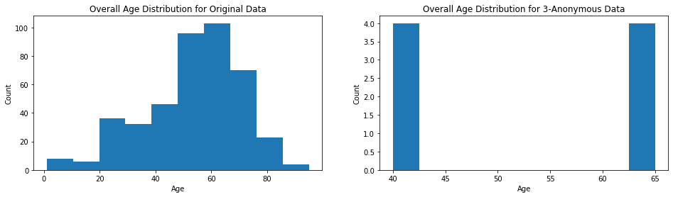
Exploratory Data Analysis of k-Anonymous Data

Slide 25
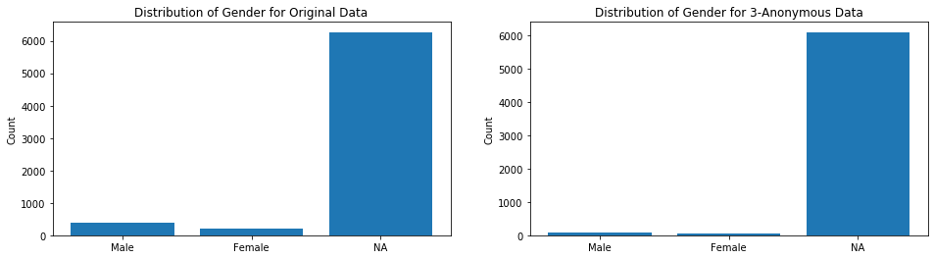
Exploratory Data Analysis of k-Anonymous Data
96 male, 48 female in 3-anonymous dataset

Slide 26
Prediction Ability of Datasets
Logistic regression of Recovery/Death on Age*, Gender, City, District, Satatecode, and Nationality (*age not available in 4- and 5-anonymous data)
87% of data is recoveries
Split data into train and test sets, evaluate on test set
94.5% accuracy for full dataset
95.9% accuracy for 3-anonymous dataset
95.7% accuracy for 4-anonymous dataset
96.8% accuracy for 5-anonymous dataset

Slide 27
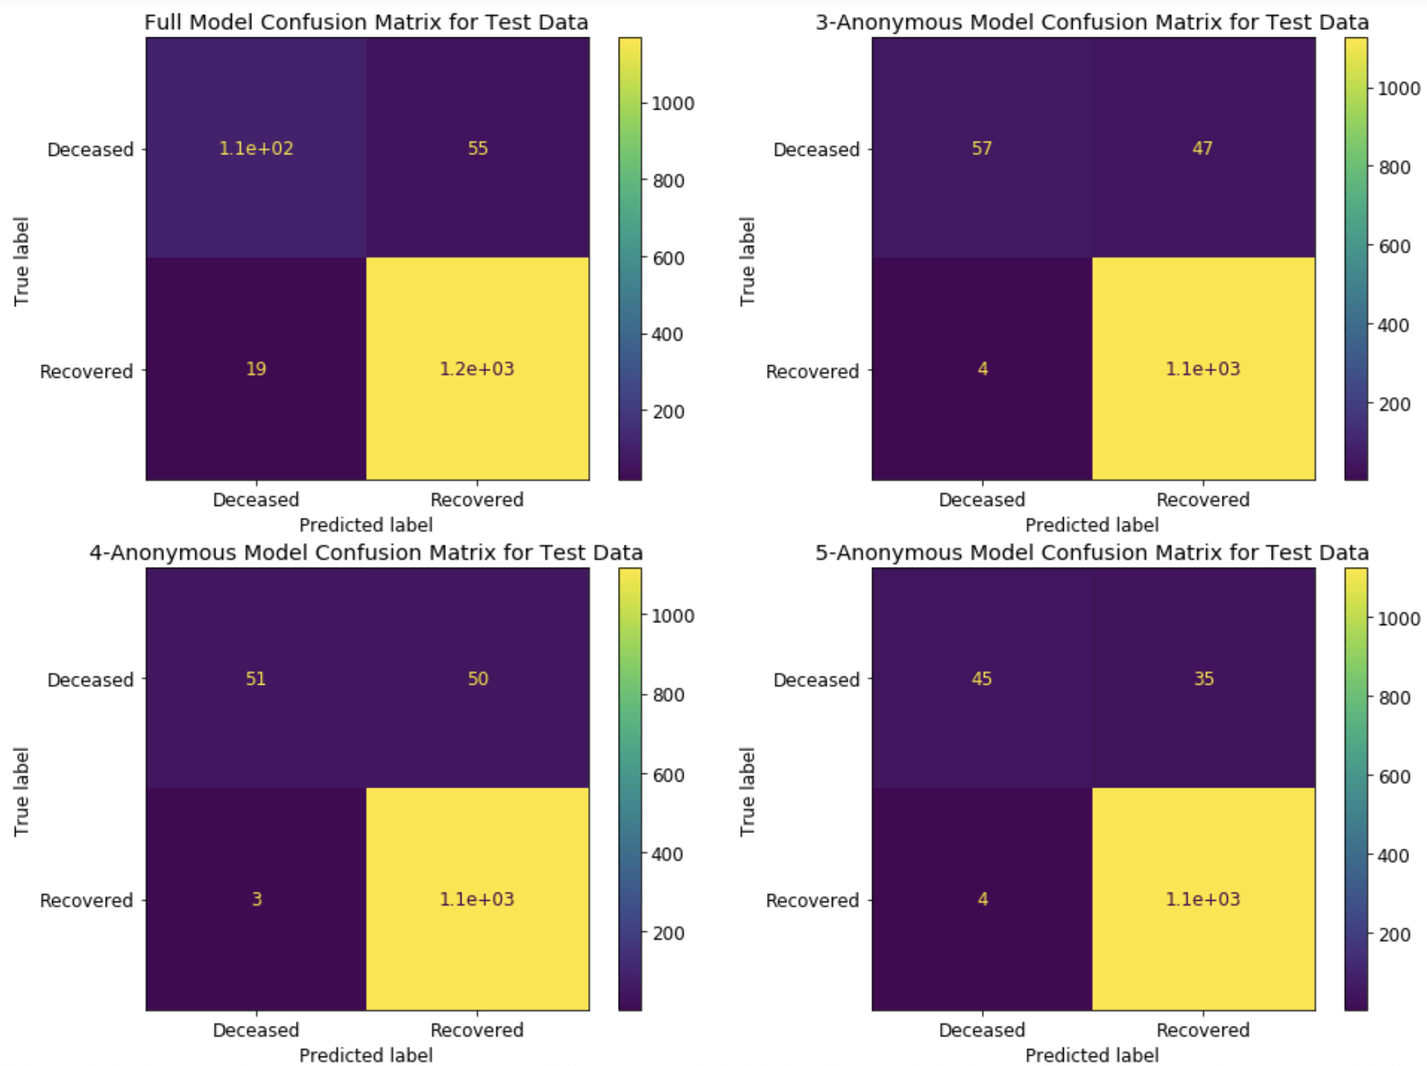
Confusion Matrix
Near perfect for recoveries
67% accuracy for deceased on full dataset, about 50% for anonymous datasets

Slide 28
India Conclusions
Missing data is good for anonymity, but bad for prediction
More missing data means fewer 1-, 2-, 3-anonymous observations
Data is already HIPAA compliant, no directory information
Data is NOT 3-anonymous or better, anonymizing the data changes distributions and loses important data
Overall prediction accuracy increases with more anonymity but accuracy per class suffers
67% accuracy for deaths with full data, only 50% on anonymized data

Slide 29
 | China | South Korea | India
Sample size | 42,334 | 3,364 | 6,853
Death rate | 19.84% (49/247) | 1.9% (67/3364) | 12.1% (824/5938)
Missing data proportion (sex) | 95% | 1.9% | 91%
Quasi-identifier | Age, gender, province, city, admin | Birth year, Age, gender, country, province, city | Age, gender, city, district, state, nationality
Original k-anonymity | 1 | 1 | 1
Accuracy change after anonymity |  | Increase | Decrease

Slide 30
Future Work
Better analyzing dataset
Try other combination of generalization/suppression of anonymizing datasets
Try to balance data using oversampling or undersampling
Try models other than linear regression and logistic regression
Extrapolate difference in policy between three countries to better explain variation
Perform literature review among literatures that protect privacy.

Slide 31
Sources
https://www.covid19india.org/
https://www.kaggle.com/kimjihoo/coronavirusdataset#PatientInfo.csv
https://www.kaggle.com/sudalairajkumar/novel-corona-virus-2019-dataset#COVID19_line_list_data.csv
https://www.kaggle.com/allen-institute-for-ai/CORD-19-research-challenge
https://github.com/CSSEGISandData/COVID-19
https://github.com/beoutbreakprepared/nCoV2019

